Slide 1
Lecture 2
Cloud Enabling Technologies

Slide 2
Cloud Enabling Technologies
Broadband networks and internet architecture
Virtualization technology
SOA
Web Services , Web 2.0,3.0
Multitenant technology

Slide 3
Broadband networks & Internet architecture
All cloud’s resources must be connected to a network
This inevitable requirement forms an inherent dependency on internetworking.
Internetworks, or the Internet, allow for the remote provisioning of IT resources and are directly supportive of ubiquitous network access.

Slide 4
Internet Service Providers (ISPs)
Established and deployed by ISPs, the Internet's largest backbone networks are strategically interconnected by core routers that connect the world's multinational networks.

Slide 5
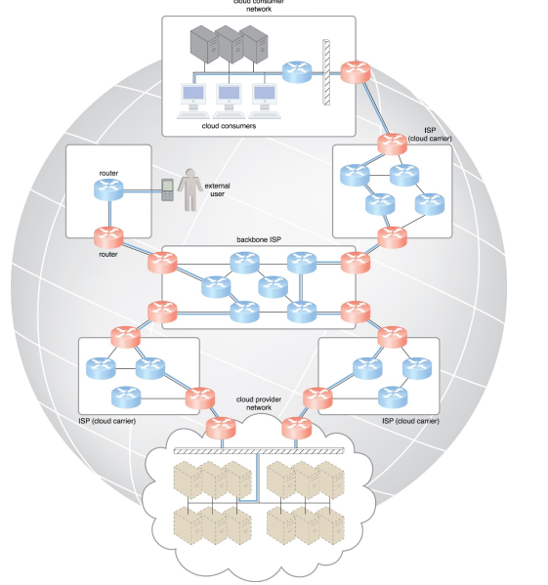

Slide 6
Cont.
Worldwide connectivity is enabled through a hierarchical topology composed of Tiers 1, 2, and 3
The core Tier 1 is made of large-scale, international cloud providers that oversee massive interconnected global networks, which are connected to Tier 2's large regional providers
The interconnected ISPs of Tier 2 connect with Tier 1 providers, as well as the local ISPs of Tier 3.

Slide 7
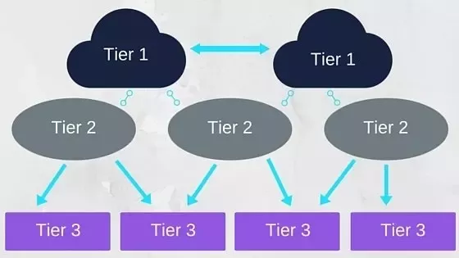
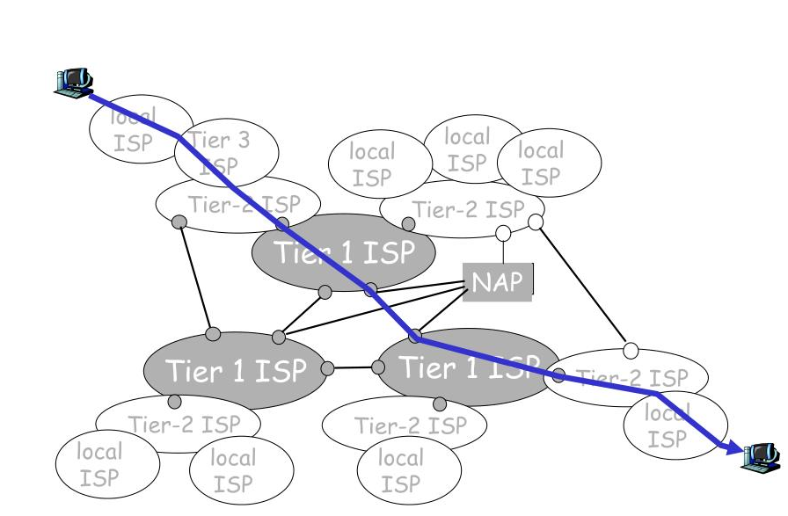

Slide 8
Internet Service Providers (ISPs) …
The communication links and routers of the Internet and ISP networks are IT resources that are distributed among countless traffic generation paths.
Two fundamental components used to construct the internetworking architecture are:
connectionless packet switching (datagram networks)
router-based interconnectivity

Slide 9
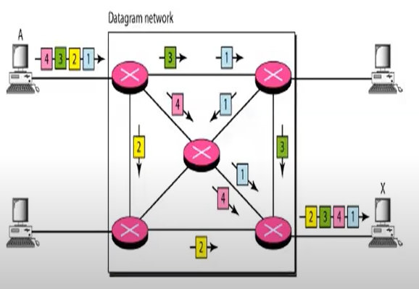
Connectionless packet switching
End-to-end (sender-receiver pair) data flows are divided into packets that are received and processed through network switches and routers, then queued and forwarded from one intermediary node to the next.

Slide 10
Connectionless packet switching …
Each packet carries the necessary location information, such as the Internet Protocol (IP) or Media Access Control (MAC) address, to be processed and routed at every source, intermediary, and destination node.

Slide 11
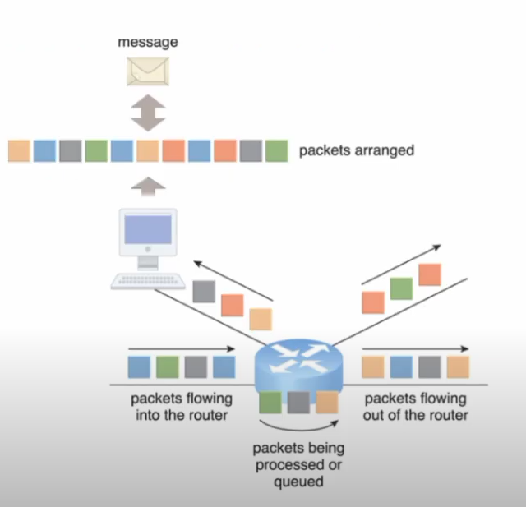
Router-based interconnectivity
A router is a device that is connected to multiple networks through which it forwards packets
Each packet is individually processed

Slide 12
Router-based interconnectivity …
The communication path that connects a cloud consumer with its cloud provider may involve multiple ISP networks
The Internet's mesh structure connects Internet hosts (endpoint systems) using multiple alternative network routes that are determined at runtime
Communication can therefore be sustained even during network failures, although using multiple network paths can cause routing fluctuations and latency.

Slide 13
Virtualization
It is a process of creating virtual instance of physical resources
It is a technique which allow to share single physical instance of a resource among multiple customer or organization
Cloud Service Provider:
Server
Virtual server ↔ virtual machine
Storage
Network

Slide 14
Benefits of Virtualization …
No Capital Expenditure
Better resource utilization
Remote access
On Demand , Pay per use

Slide 15
SOA?

Slide 16
Case Study
Online Parking Ticket Application:
Maps, Payments, User login & Authentication
Maps - Google Maps
Payments -Existing payment gateway
User Authentication – Facebook Gmail
The building-block services might employ pre-existing components that are reused, and can also be updated or replaced without affecting the functionality or integrity of other independent services
In the consumer Web, information and services may be programmatically aggregated, acting as building blocks of complex compositions, called service mashups.

Slide 17
Service
Software component that provides a set of coherent functionalities that can be reused and integrated into bigger and more complex applications
Services are most often built in a way that is independent of the context in which they are used
A service is supposed to be
Loosely coupled- allows services to serve different scenarios more easily
Reusable
Programming language independent-increases services accessibility
location transparent

Slide 18
SOA: Service Oriented Architecture
Service-orientation is a way of thinking in terms of services and service-based development and the outcomes of services
Service orientation approach adopts the concept of services as the main building blocks of application and system development
It defines a way to make software components reusable via service interfaces

Slide 19
SOA: Service Oriented Architecture
SOA is a logical way of designing a software system to provide services to either end-user applications or to other services distributed in a network, via published and discoverable interfaces
This architectural approach is particularly applicable when multiple applications running on varied technologies and platforms need to communicate with each other

Slide 20
Web services
Web services are the prominent technology for implementing SOA systems and applications
A Web service is a self-describing, self-contained software module available via a network, such as the Internet, which completes tasks, solves problems, or conducts transactions on behalf of a user or application.
Self-describing: It knows what functions it can perform and what inputs it requires to produce its outputs.
It can also describe its non-functional properties like cost of invoking the service, the geographical areas the Web service covers etc.
It can describe this to potential users & other Web services

Slide 21
Web services …
A Web service can be:
Self-contained business task-funds withdrawal/deposit
Full-fledged business process- automated purchasing of office supplies
An application- life insurance application or demand forecasts and stock replenishment
Web services vary in function from simple requests (pricing enquiries, weather report) to complete business applications ( package tracking system) that access and combine information from multiple sources

Slide 22
Web 2.0/3.0
The Web is the primary interface through which cloud computing delivers its services.
Web encompasses a set of technologies and services that facilitate interactive information sharing, user-centered design, and application composition.
This evolution has transformed the Web into a rich platform for application development and is known as Web 3.0

Slide 23
Multitenant technology
What is Tenant?
A person who occupies land or property rented from a landlord.
A consumer who consumes services (as SaaS, laaS or PaaS) offered by Cloud Service Providers.
Multi-Tenancy
Have multiple tenants/occupants.
Software that is shared by several consumers
Each consumer is unaware of the others

Slide 24
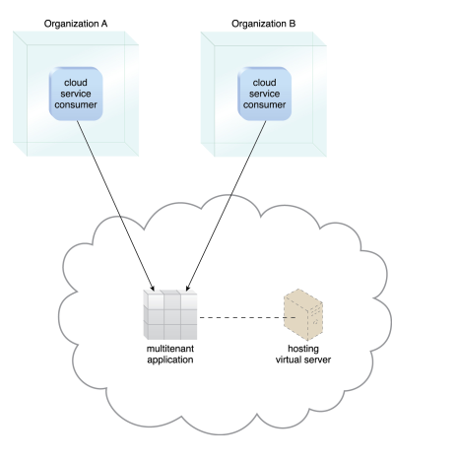
A simple example

